Slide 1
Biology 2672a
Biological Clocks

Slide 2
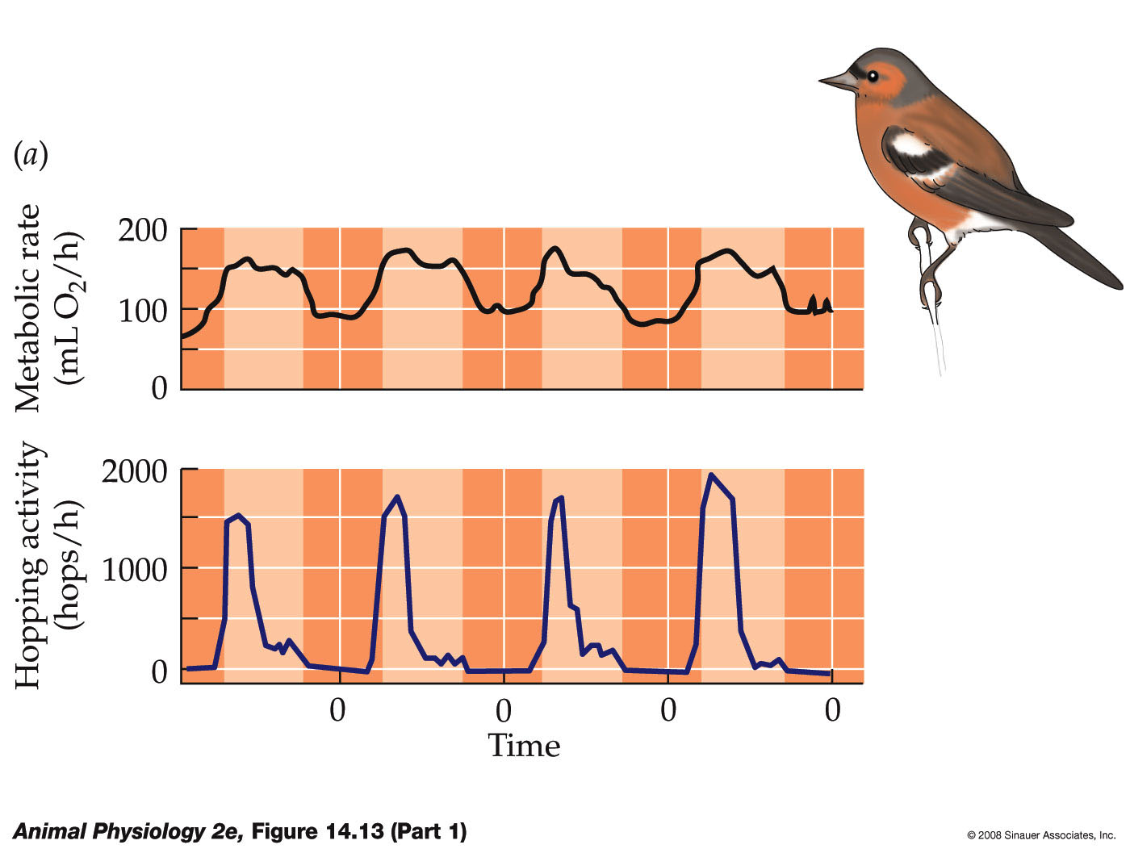
Biological Rhythms

Slide 3
Kinds of biological rhythms
Daily
Circadian
Infradian
Circatidal
Longer term
Circannual
Circalunar

Slide 4
Biological rhythms are often entrained to an external cue
‘Free-running’
Without external cue
Zeitgeber
German: “time-giver”
The external cue

Slide 5
A free-running circadian cycle in flying squirrels
Black bars indicate periods of activity
In the absence of external cues, many circadian rhythms are >24 h long...

Slide 6
But they are tightly linked when entrained by light/dark

Slide 7
How do the endogenous rhythms work?
Cyclic expression of genes
Clock, period, timeless, cryptochrome
The products of these genes mediate other effects in the organism

Slide 8
-
clock gene transcription
Bmal1 gene transcription
-
REV-ERBα
Protein is a transcription factor
Clock
BMAL1
+
+
PER + CRY protein complex
rev-erbα
per and cry transcription
+
Breaks down in a time-dependent manner
Signalling in rest of body = physiological responses
Timekeeping in mammals...See also Figure 14.15

Slide 9
Clock genes (in words)
Clock-BMAL1 heterodimers increase production of per and cry
PER+CRY complexes inhibit the Clock-BMAL1 heterodimer... But break down in a time dependent manner
ie: the inhibitory effect only lasts a while
Clock-BMAL1 heterodimers affect physiological responses (circadian responses)
Also self-regulating via rev-erbα
These cycles of breakdown and production occur on a circadian basis, providing the basis for the circadian rhythm

Slide 10
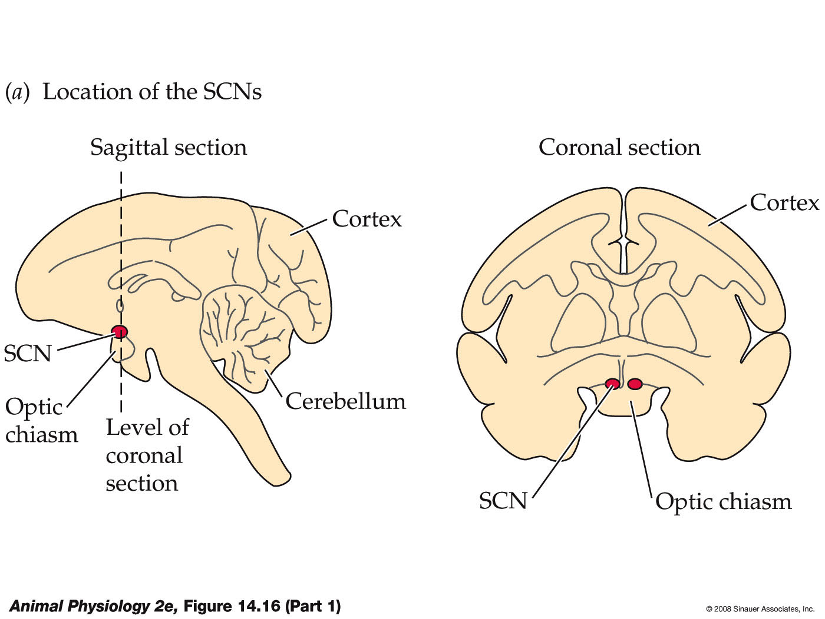
The cells that do the timekeeping in mammals are located in the Suprachiasmatic Nuclei

Slide 11
If the SCN is removed, the circadian rhythm breaks down
SCN removed here

Slide 12
How are they entrained?
Daylength cues to the brain
Hypothalamus
Pineal
Melatonin release
(inhibited by light)

Slide 13
Melatonin cycles
Retinal cells that sense light are not normal visual cells
‘Blind’ animals like blind mole rat still respond to photoperiod
Specific opsin molecules (melanopsin)
In the Pineal, melatonin production is controlled by
Light-dependent control of NAT (rodents)
(n-acetyl transgferase, the rate limiting enzyme in production of melatonin)
Light-dependent breakdown of NAT (ungulates)

Slide 14
Tuatara Sphenodon
Tuatara have a ‘pineal eye’ – a direct way for light to influence brain structures.

Slide 15
Cycles in Melatonin send day/night signals to other tissues in the body
Melatonin Titre
Midnight
Midnight

Slide 16
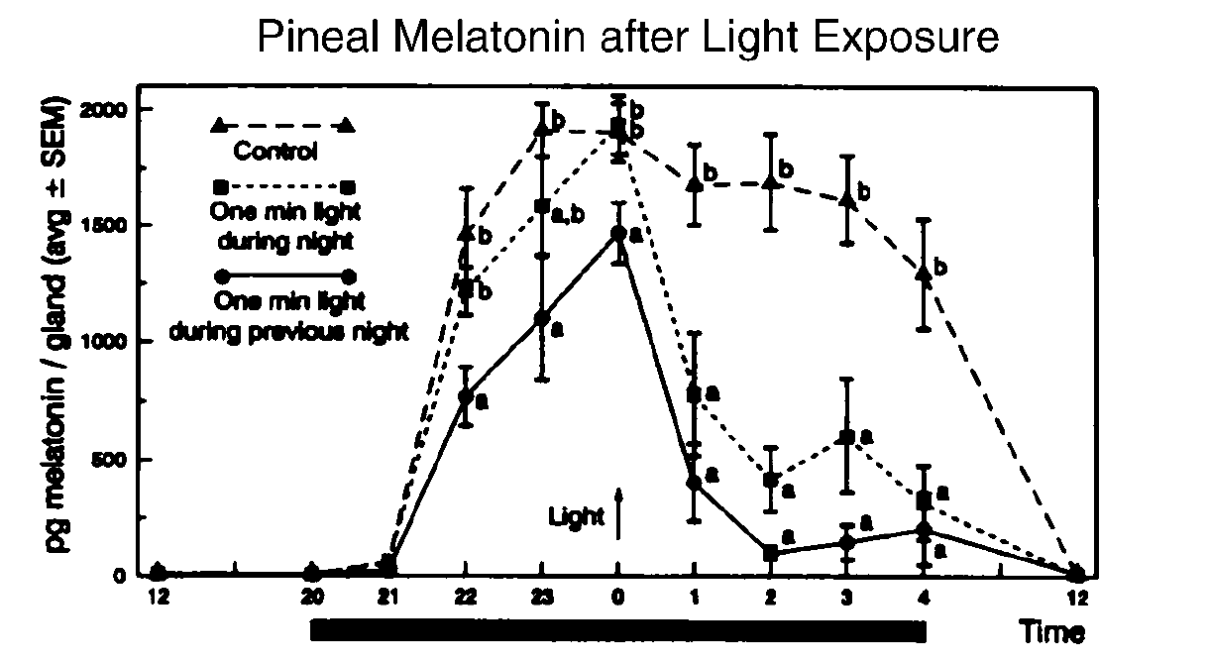
The melatonin production cycle is easily interrupted by a burst of light

Slide 17
How do mammals know what season it is?
Winter: Long night (Melatonin elevated for a long time)
Melatonin Titre
Summer: Short night (Melatonin elevated for a short time)
Midnight
Midnight

Slide 18
Melatonin signals are decoded in the pituitary gland
Calendar cells measure length of melatonin burst against clock gene cycles
Then regulate pituitary production of (e.g.) gonadotropin, luteinising hormone, leptin, prolactin etc. that control seasonal endocrine changes.

Slide 19
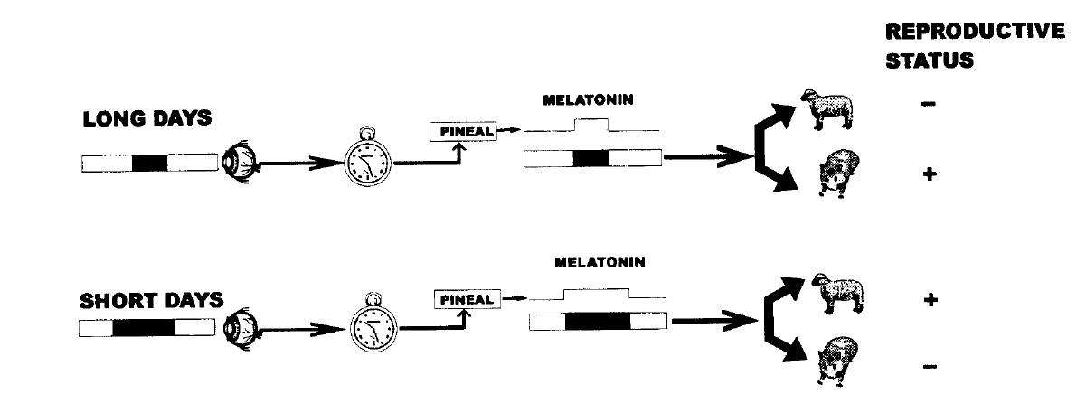
Effects are species-specific
Sheep
Hamster

Slide 20
There is generally a ‘critical photoperiod’
Most vertebrates are measuring whether the daylength is longer or shorter than the critical photoperiod
Often 12.5-14 h light
Some insects measure length of day, others measure changing daylength

Slide 21
Local timing is essential
Determines when animals become active, migrate
Timing with food resources and bad weather
Mismatched timing with seasonality can be a cause of failure for introduced species
Insect biocontrol agents don’t know when winter will end
Ungulate populations get timing of birth wrong

Slide 22
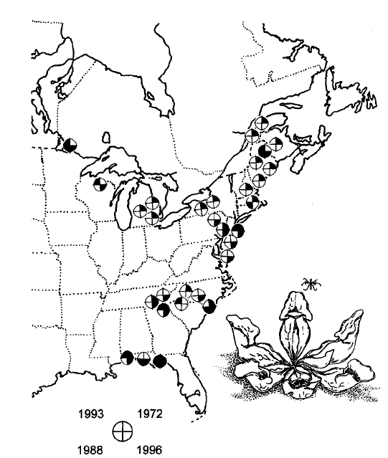
Pitcher plant mosquitoes:
critical photoperiod differs with latitude (longer in north, where growing seasons are shorter)
Altitude-corrected latitude
Length of critical photoperiod has been decreasing as a result of natural selection by climate change

Slide 23
Reading for Tuesday
Diving Mammals
Pp 643-660

