Slide 1
International Economics Tenth Edition
CHAPTER S I X T E E N
16
The Price Adjustment Mechanism with Flexible and Fixed Exchange Rates
Dominick Salvatore
John Wiley & Sons, Inc.

Slide 2
Learning Goals:
Understand the effect of a change in the exchange rate on the nation’s current account
Understand the meaning and importance of the “stability of the foreign exchange market”
Understand the meaning and importance of the exchange rate “pass-through”
Explain how the gold standard operated

Slide 3
Introduction
Assumptions
International private capital flows take place only as passive responses to cover temporary trade imbalances.
The nation wants to correct a deficit in its current account by exchange rate changes.

Slide 4
Adjustment with Flexible Exchange Rates
Price adjustment mechanism relies on depreciation and devaluation of currency to adjust current account and balance of payments.
Income adjustment mechanism relies on income changes in the nation and abroad to make the adjustments.
Elasticity of the demand and supply curves will determine effectiveness of adjustment mechanisms.

Slide 5
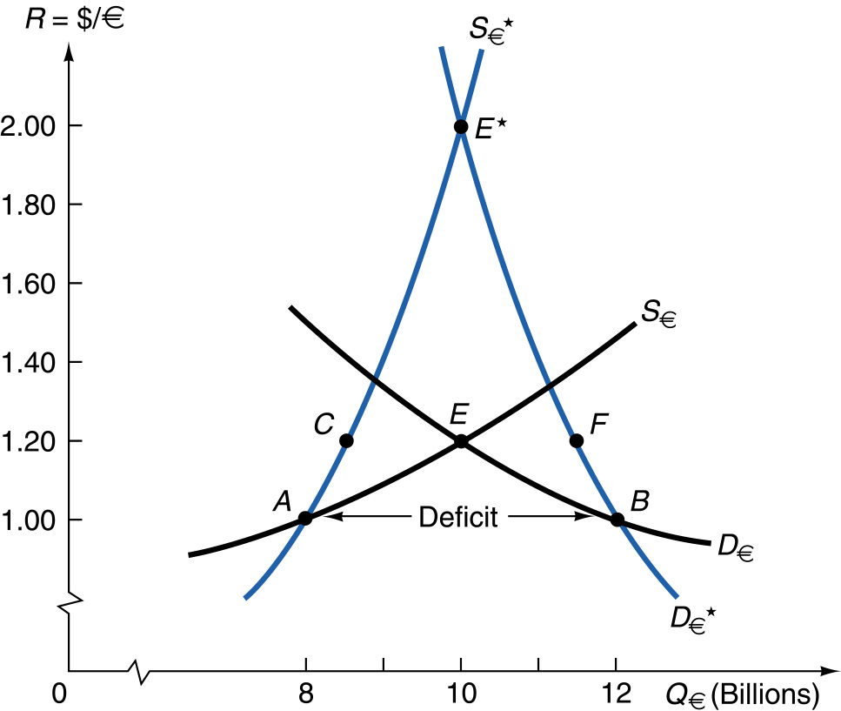
FIGURE 16-1 Balance-of-Payments Adjustments with
Exchange Rate Changes.

Slide 6
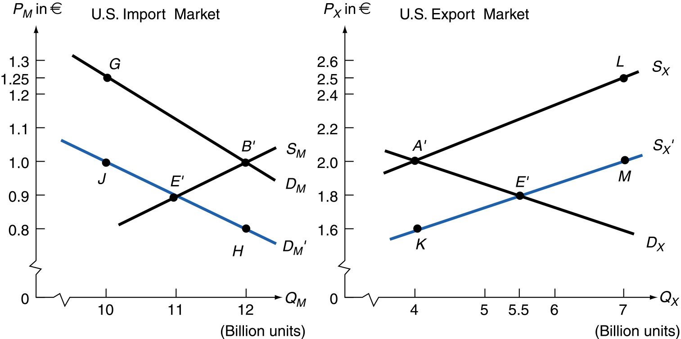
FIGURE 16-2 Derivation of the U.S. Demand and Supply Curves for Foreign Exchange.

Slide 7
Effect of Exchange Rate Changes on Domestic Prices and the Terms of Sale
The greater the devaluation or depreciation of the dollar, the greater its inflationary impact, and the less feasible is the increase of the exchange rate for correcting balance of payments deficits.

Slide 8
Effect of Exchange Rate Changes on Domestic Prices and the Terms of Sale
Depreciation of the currency increases prices of both exports and imports in terms of domestic currency.
Terms of trade can rise, fall or remain unchanged, depending on the relative magnitude of the price changes.

Slide 9
Stability of Foreign Exchange Markets
Unstable foreign exchange market - when a disturbance from equilibrium pushes the exchange rate further away from equilibrium.
Supply curve is negatively sloped and more elastic than the demand curve of foreign exchange.
Flexible exchange rate system increases (rather than reduces) a balance of payments disequilibrium.

Slide 10
Stability of Foreign Exchange Markets
Stable foreign exchange market - when a disturbance from equilibrium gives rise to automatic forces that push exchange rate back to equilibrium.
Supply curve is positively sloped, or if negatively sloped, is less elastic than the demand curve of foreign exchange.

Slide 11
FIGURE 16-3 Stable and Unstable Foreign Exchange Markets.

Slide 12
Stability of Foreign Exchange Markets
Marshall-Lerner condition - Sum of the price elasticities of demand for imports and demand for exports is (in absolute terms) indicates degree of foreign exchange market stability:
Greater than 1 = stable foreign exchange market
Devaluation required to correct BOP deficit.
Less than 1 = unstable foreign exchange market
Revaluation required to correct BOP deficit.
Equal to 1 = change in exchange rate leaves balance of payments unchanged.

Slide 13
Elasticities in the Real World
Empirical evidence suggests that the Marshall-Lerner condition holds for the foreign exchange market, indicating a stable market.
Quantity response to price change must be measured over longer time periods for accurate elasticity measures.

Slide 14
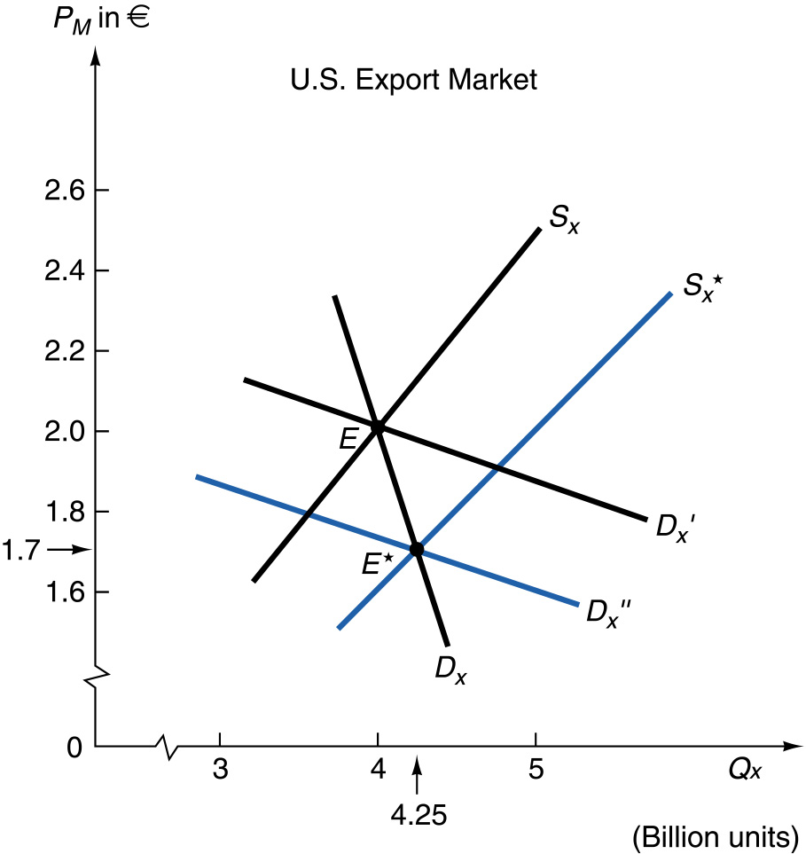
FIGURE 16-4 The Identification Problem.

Slide 15
Elasticities in the Real World
Junz and Rhomberg (1973) identified five possible lags in quantity responses to price changes in international trade:
Recognition lag before price change becomes evident.
Decision lag to take advantage of price changes.
Delivery lag of new orders placed
Replacement lag to use up available inventories before placing new orders.
Production lag to change output mix resulting from price changes.

Slide 16
Elasticities in the Real World
J-Curve Effect
A nation’s trade balance may actually worsen soon after devaluation or depreciation before improving later on.
This occurs because import prices tend to rise faster than export prices, with quantities initially not changing much.
Over time, export prices catch up with import prices so initial deterioration in trade balance is reversed, generating a J-shaped pattern to exchange rate movements.

Slide 17
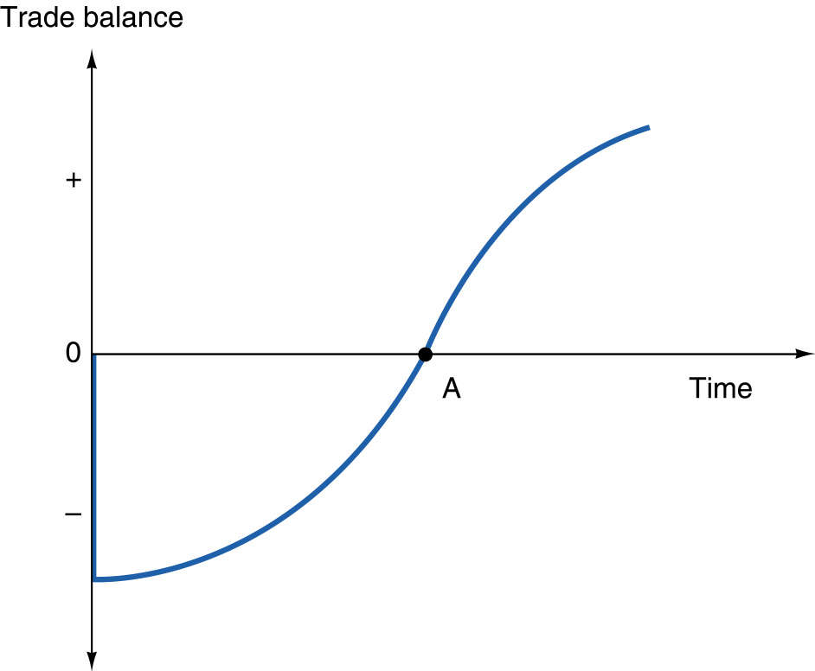
FIGURE 16-5 The J-Curve.

Slide 18
Currency Pass-Through
Changes in exchange rates may not be fully reflected in the price of imported goods.
For example, a 10% depreciation of the currency may lead to a less than 10% increase in import prices.
For the United States, it is estimated that the pass-through from dollar depreciation is about 42%.

Slide 19
Currency Pass-Through, continued
Exporters may not be willing to pass on the full price increase due to fears of losing market share
It is costly to build new production and distribution facilities and to enter or leave markets.
This beachhead effect implies that pass-through is likely to be incomplete, particularly in the short run.

Slide 20
Adjustment Under the Gold Standard
The gold standard operated from about 1880 to outbreak of World War I in 1914.
Attempt to reestablish gold standard after the war failed in 1931 during Great Depression.
Advantages and disadvantages of gold standard also apply to fixed exchange system (Bretton Woods, or gold-exchange standard) operating from World War II until its collapse in 1971.

Slide 21
Adjustment Under the Gold Standard
Under the gold standard, each nation specified the gold content of its currency:
£1 gold coin contained 113.0016 grains of gold
$1 gold coin contained 23.22 grains of gold
This implies a fixed exchange rate, or mint parity, of:
R = $/£ = 113.0016 / 23.22 = $4.87/£

Slide 22
Adjustment Under the Gold Standard
The cost of shipping gold from New York to London was approximately 3 cents.
So, the actual exchange rate would always lie between $4.84/£ (gold import point) and $4.90/£ (gold export point).

Slide 23
Adjustment Under the Gold Standard
The tendency of the dollar to depreciate (rise above gold export point) was countered by gold shipments from the United States.
Gold outflows = size of U.S. balance of payments deficit.
The tendency of the dollar to appreciate (fall below gold import point) was countered by gold shipments to the United States.
Gold inflows = size of U.S. balance of payments surplus.

Slide 24
Adjustment Under the Gold Standard
The price-specie-flow mechanism is the automatic adjustment mechanism under the gold standard.
If a trade imbalance exists, gold will flow from the country with a trade deficit to the country with a trade surplus.
The fall in gold supplies in the trade deficit country reduces its money supply and pushes its price level lower.
The increase in gold supplies in the trade surplus country increases its money supply and raises its price level.

Slide 25
Adjustment Under the Gold Standard
The price level movement is based on the quantity theory of money:
MV = PQ
where M = money supply
V = velocity of circulation of money
P = general price index
Q = physical output

Slide 26
Adjustment Under the Gold Standard
As the price level falls in the country with a trade deficit, exports of its goods and services will be encouraged.
As the price level increases in the country with a trade surplus, exports of its goods and services will be discouraged.
These changes in trade will decrease both the trade deficit and surplus leaving a situation of balanced international trade.

Slide 27
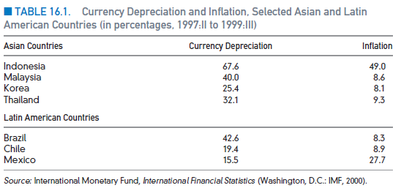
Case Study 16-1 Currency Depreciation and Inflation in Developing Countries during the 1997-1998 East Asian Crisis

Slide 28
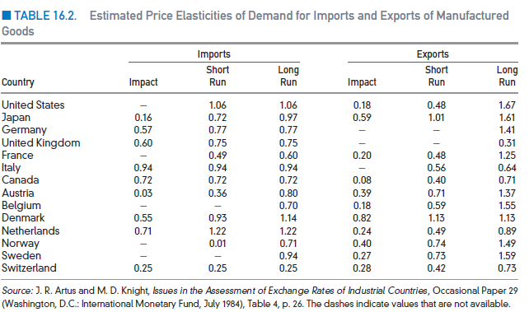
Case Study 16-2 Estimated Price Elasticities in International Trade

Slide 29
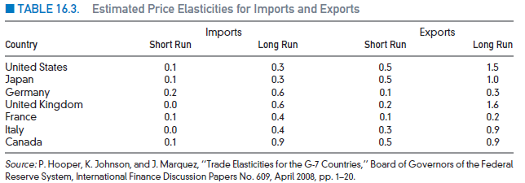
Case Study 16-3 Other Estimated Price Elasticities in International Trade

Slide 30
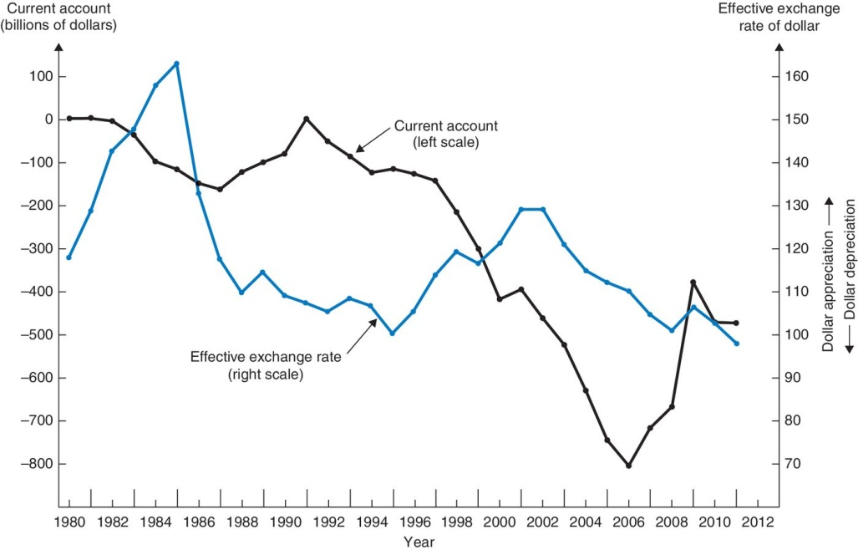
Case Study 16-4 Effective Exchange Rate of the Dollar and the U.S. Current Account Balance
FIGURE 16-6 Effective Exchange Rate of the Dollar and U.S. Current Account Balance, 1980-2005.

Slide 31
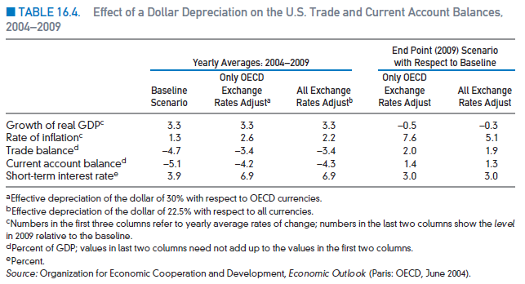
Case Study 16-5 Dollar Depreciation and the U.S. Current Account Balance

Slide 32
Case Study 16-6 Exchange Rates and Current Account Balances during the European Financial Crisis of the Early 1990s

Slide 33
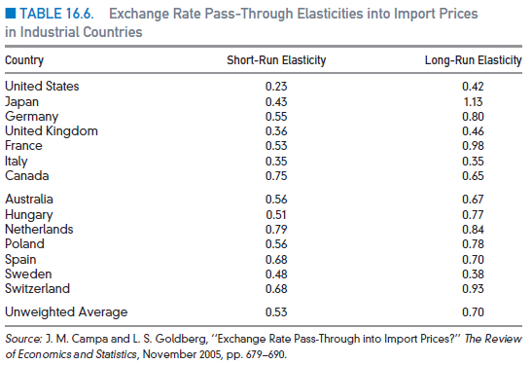
Case Study 16-7 Exchange Rate Pass-Through to Import Prices in Industrial Countries

Slide 34
Appendix to Chapter 16
Effect of Exchange Rate Change on Domestic Prices
Currency depreciation or devaluation decreases the supply for home-country imports (in terms of the domestic currency ) and increases the demand for home-country exports (in terms of the domestic currency.
Thus import and export prices rise, in domestic-currency terms.
This price change is necessary to induce changes in production or consumption, but reduces the export price advantage from the depreciation.

Slide 35
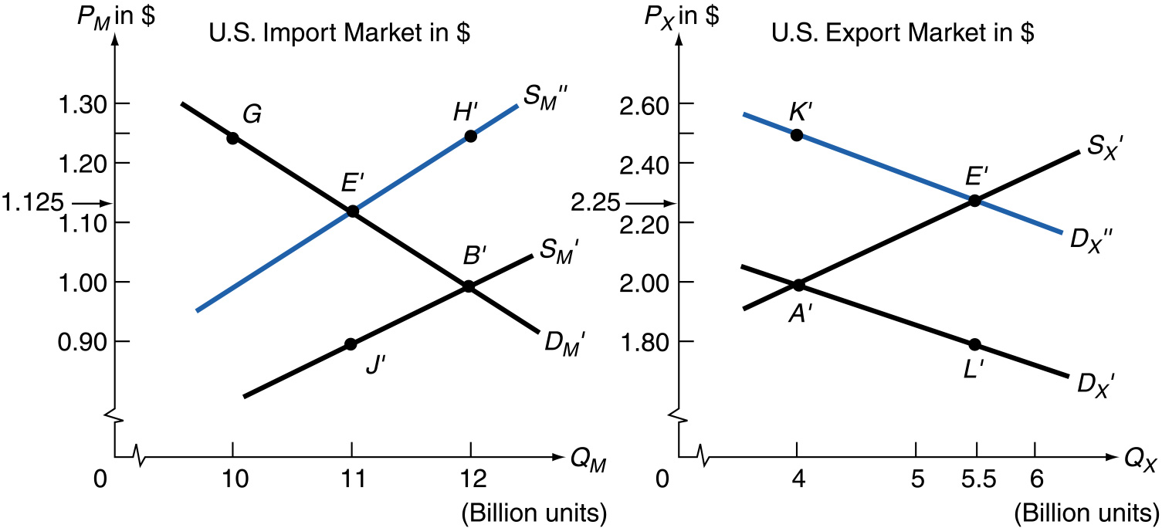
FIGURE 16-7 Effect of a Depreciation or Devaluation on
Domestic Prices.

Slide 36
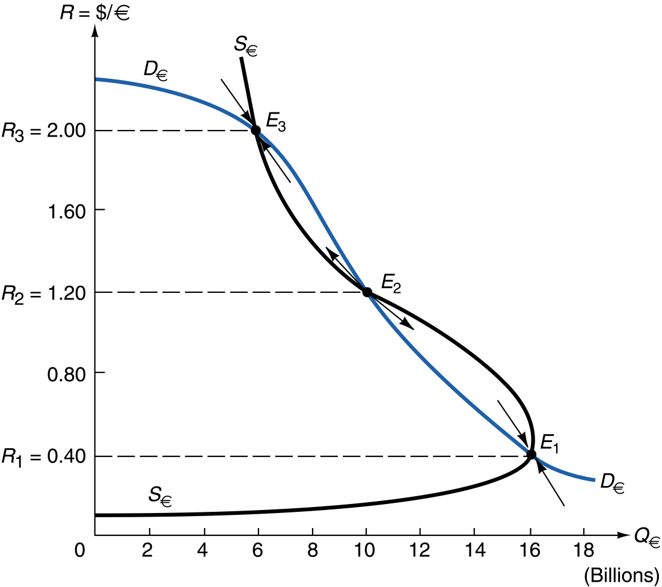
FIGURE 16-8 An Unstable Foreign Exchange Market Becomes Stable for Large Exchange Rate Changes.

Slide 37
Appendix to Chapter 16
Derivation of the Marshall-Lerner Condition
The trade balance is
B = $Q_{X}P_{X}−P_{M}Q_{M}$
For a small devaluation, the change in the trade balance is
dB = ${P_{X}dQ}_{X}+{Q_{X}dP}_{X}−({P_{M}dQ}_{M}+{Q_{M}dP}_{M}$)
Using rules of differentiation to simplify, rearranging, and rewriting in terms of elasticities
dB = k(${P_{X}dQ}_{X}{(η}_{X}−1)+η_{M}{P_{M}dQ}_{M})$
where k = ${dP_{M}/P}_{M}$

Slide 38
Appendix to Chapter 16
Derivation of the Marshall-Lerner Condition
The initial level of the trade balance is significant for the relative importance of the elasticities.
If the elasticity of foreign supply of domestic imports and domestic supply of exports are not infinite, then the Marshall-Lerner condition becomes
$$\frac{e_{M} e_{X}(η_{M}\text{+ }η_{X}−1)+ η_{M} η_{X}\text{ (}e_{M}\text{+ }e_{X}+1)}{\text{(}e_{X}\text{+ }η_{X})(e_{M}\text{+ }η_{M})}$$

Slide 39
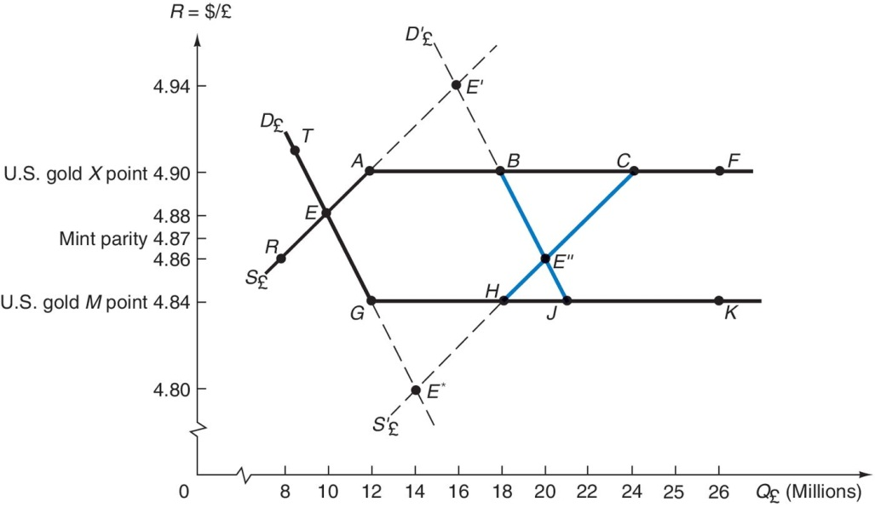
Appendix: Derivation of Gold Points
FIGURE 16-8 Gold Points and Gold Flows.

Slide 40
Copyright 2013 John Wiley & Sons, Inc.
All rights reserved. Reproduction or translation of this work beyond that permitted in section 117 of the 1976 United States Copyright Act without express permission of the copyright owner is unlawful. Request for further information should be addressed to the Permissions Department, John Wiley & Sons, Inc. The purchaser may make back-up copies for his/her own use only and not for distribution or resale. The Publisher assumes no responsibility for errors, omissions, or damages caused by the use of these programs or from the use of the information herein.
Notes:
Case studies and tables.

