Slide 1
USA & Global Financial Crisis

Slide 2
What is the Global Financial Crisis?
The Global financial crisis is believed to be the largest financial crisis after the “The Great Depression”. The crisis started becoming visible from 2007 when US investors started to loose confidence in sub-prime mortgages causing the liquidity crisis. This led to injection of large amounts of capitals by the US Federal Bank into the financial markets. As the crisis worsened stock markets began to fall, large financial institution starting collapsing in the wealthiest nations greatly effecting the global economy.
Summary:
Low interest rates, high leverage and overconfidence led to the creation of bubbles in the housing market sector which later on burst

Slide 3
Where it Began?
According to many economists the root cause of this crisis originally began from United States. During the early 20th century, the American real estate sector was booming taking their economy to a new level. Large inflows of foreign liquid funds and all time low interest rate lead to lenient credit conditions. Banks and loan providing agencies broaden their loan disbursement making easier for people to take property loans. In results this allowed people who came under NINJA (No Income, No Job, No Assets) category get loans easily. The increasing number of house loans lead to the increased demand for property purchases raising the house prices in the US. Americans who had taken out sub-prime loans later on realized they were unable to pay back their mortgage. This caused large number of defaults in house loans , Banks were faced with a situation where the repossessed houses and land were worth less on today's market than the bank had loaned out originally leading banks to face liquidity crisis.

Slide 4
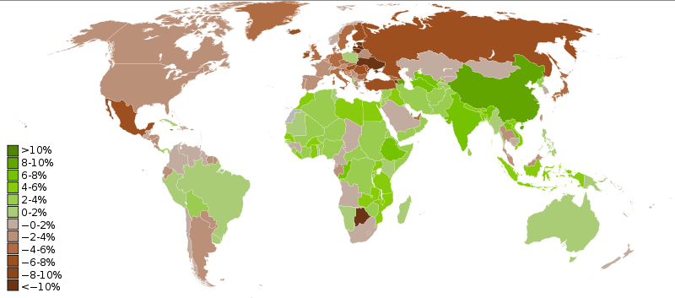
GDP Real Growth 2009
Countries shown in in brown are facing recession

Slide 5
During the Recession
When an economy is weak or is going through a recession like the US & majority of the European regions at this time, most governments have done the following to support their economy during the crisis:
At such times governments attempt to stimulate the economy. Standard macroeconomic policy includes policies to
Increase borrowing,
Reduce interest rates,
Reduce taxes, and
Spend on public works such as infrastructure.
Countries that have applied some of the above facts are: South Korea, Japan, China, England, European countries and many others

Slide 6
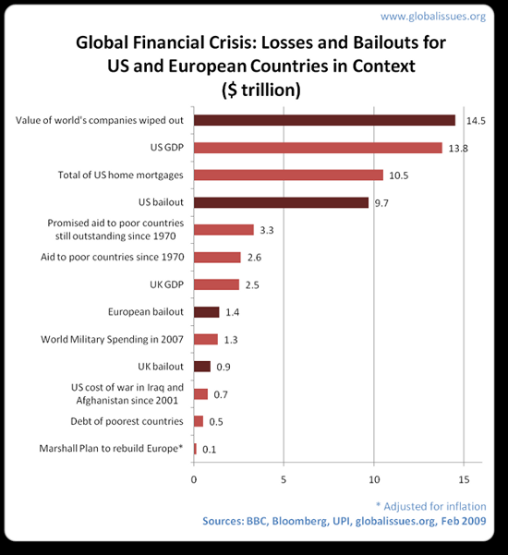

Slide 7
Government’s Response
Lowered Interest rates
Increase Money supply
Some government reduced their taxes & increased investment to save their economy from going further in to a recession
Many governments have used past examples like “The Great Depression” to tackle the current crisis by apply Keynes theory and reacting quickly to save further damage to the economy
Liquidity to banking systems had been provided by Central Banks for their continuous functioning
Central banks stepped in and provided liquidity to the banking system allowing it to keep functioning
Many large financial institution had been provided with bail out packages

Slide 8
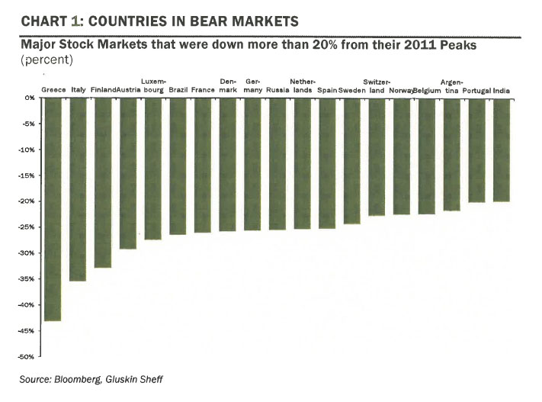

Slide 9
Effecting the Global Economy
Weaker export revenues
More pressures on current accounts and balance of payments
Lower investment and growth rates
Higher rates of unemployment
Financial Contagion and spillovers for stock markets
Commercial lending would decrease, Banks under pressure in developed countries may not lend as much, due to the risk emerging countries may default their debt
Aid budgets under pressure due to debt problems & weak fiscal positions
Countries with significant exports large effected nations like USA & Europe
Countries exporting products whose prices are affected or prices with high income elasticity

Slide 10
Impact of the Crisis
Collapsing of Large financial institutions
ex. AIG JP Morgan , Lehman Brother and etc
Central Banks in weak countries risk the chances of
bankruptcies
Businessman and foreign investors risk largement investment over a short period of time
Credit and Liquidity crunch risks for industries even in the wealthiest countries
ex. automotive and housing sector
Demand for various goods & services decline during crisis
Consumer becoming cautious about their spending effecting businesses

Slide 11
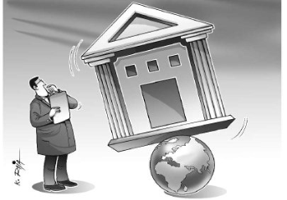
Foreign Countries Respond
In response to the spread of financial crisis many countries announced bail out packages to prevent their own economies from getting severely hit:
China announced $586 billion worth of stimulus package aiming the growth and the domestic consumption within some areas of their economy.
Australia itself had quickly responded and had announced $10.4 billion initial bail out while their 2nd stimulus package consisted of even a larger stimulus packet worth nearly $47 billion:
$6.6 billion for 20,000 new homes
$3.9 billion to insulate 2.7 million homes
$890 million for road repairs and infrastructure
$2.7 billion in small business tax breaks
$12.7 billion for cash bonuses: $950 for every Australian taxpayer who earned less than $80,000, to be paid out in March and April 2009
$14.7 billion for schools

Slide 12
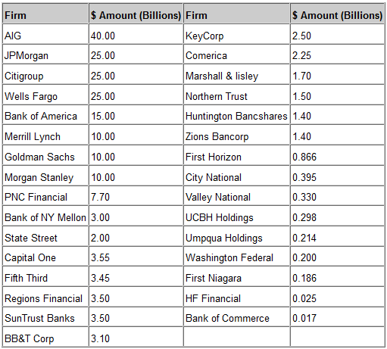
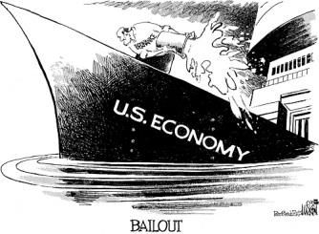
Investments from the US Treasury
In 2008 the conditions of continued to weaken, provoking the Treasury to invest directly in to companies companies rather than purchasing their assets from their balance sheet since thing would be more efficient & faster. This led the treasury to invest $125 billion in 9 of the largest U.S. banking institutions & another $125 billion in to smaller firms.
(As of 2008)

Slide 13
Was Prevention an Option?
"The crisis was the result of human action and inaction. The captains of finance and the public stewards of our financial system ignored warnings and failed to question, understand, and manage evolving risks within a system essential to the well-being of the American public.“
The first and far most important which was the leading cause of the crisis, mortgage brokers who gave away bad loans, hedge funds and etc. should have been regulated. Upon providing the loan, eligibility for repayment should have taken into accountability.
Certainly the crisis could’ve been prevented from occurring, according to economists crisis could have been forecasted from 2006 where the Commerce Department had reported new home permits declined 28% from the following year. Therefore regulation of few financial sectors & institutions that could’ve prevented the crisis

Slide 14
References
http://idioland.com/wp-content/uploads/2010/02/financial-crisis.jpg
http://www.spotlightofpeace.com/wp-content/uploads/2010/12/Global-Financial-Crisis.jpg
http://www.globalissues.org/article/768/global-financial-crisis#DevelopingworldsavingtheWest
http://commons.wikimedia.org/wiki/File:GDP_Real_Growth.svg
http://2.bp.blogspot.com/-Aoa1sI7j3ow/TdEuvCxp9mI/AAAAAAAAADA/LLjoQZwnzsc/s1600/economic-trends.jpg
http://montaraventures.com/blog/wp-content/uploads/2008/07/cash.jpg
http://www.investopedia.com/university/credit-crisis/credit-crisis6.asp#axzz1gHKmpeA8
http://www.etftrends.com/wp-content/uploads/2011/03/89690020.jpg
http://chineseculture.about.com/od/thechinesegovernment/a/Chinaeconomy.htm
http://useconomy.about.com/od/criticalssues/a/prevent_crisis.htm
http://1.bp.blogspot.com/-2FG83aU9vWo/TiIS19I9XOI/AAAAAAAAPA8/H_qkTTVDn_o/s400/best-debt-relief-15.jpg
http://www.biojobblog.com/uploads/image/bailout.gif
http://www.globalissues.org/article/768/global-financial-crisis#Dealingwithrecession
http://higheredstrategy.com/wp-content/uploads/2011/08/ImageProxyServlet.jpeg
http://static4.depositphotos.com/1009112/353/i/450/dep_3531026-Economy-Recession-Concept.jpg
http://english.peopledaily.com.cn/90001/90778/7275661.html
http://www.free-press-release.com/members/members_pic/200906/img/1246237171.jpg
http://www.cse-assoc.com/wp-content/uploads/2011/09/businessrecession.jpg
http://www.canstar.com.au/global-financial-crisis/
http://omiusajpic.org/files/2009/05/2007082750430801.jpg
http://www.zerohedge.com/contributed/three-charts-explaining-financial-crisis
http://www.theindianblogger.com/problems/reasons-for-global-recession-in-plain-simple-english/
http://8acollective.com/finance/causes-of-global-financial-crisis.html
http://www.odi.org.uk/resources/docs/3339.pdf

