Slide 1
N=1 Designs – Outline
Definition
Comparison with group designs
Causal logic – “Always and Only”
The baseline concept
The ABAB design
The Multiple Baseline Design

Slide 2
N = 1 designs: definition
In N = 1 designs, data are analyzed one subject at a time.
We often run more than one subject in such designs
But we analyze the data one subject at a time.

Slide 3
Comparison with group designs
Group designs:
Eliminate alternative hypotheses by
assigning subjects to treatment groups randomly
by avoiding confounded variables.
N=1 designs
No assignment of subjects to conditions.
Instead, we arrange things so that a change in behavior occurs always and only when the treatment occurs.

Slide 4
Always and Only
Always – whenever the treatment occurs, the change in behavior occurs.
Only – the change in behavior does not occur unless the treatment occurs.
If both these things are true, then we can legitimately claim our manipulation caused the change in behavior.

Slide 5
The Baseline Concept
A baseline measure tells us what the behavior is like in the absence of any intervention.
We always begin an n=1 study by making baseline observations.
Baseline is measured on a dimension such as frequency or intensity of behavior – something we can assign a number to.
Notes:
Assuming we can assign a number to the behavior of interest – e.g., frequency, intensity –

Slide 6
The Baseline Concept
If baseline is stable, begin intervention.
Freq
Time
Notes:
Here, the idea is that the baseline measure of behavior frequency is stable – but at a level that we don’t like. This might be a measure of some aversive behavior such as spoon-banging at meal times – in which case it would be too high – or a measure of number of times the subject makes eye contact or initiates conversation – in which case it would be too low. Either way, if the baseline is too high or too low, we intervene in order to change it.

Slide 7
The Baseline Concept
If baseline not stable, stabilize it before intervention.
Freq
Time
Notes:
Assuming we can assign a number to the behavior of interest – e.g., frequency, intensity –

Slide 8
The Baseline Concept - review
Baseline data tell you what behavior is like with no intervention
Frequency of behavior is typically of interest
Behavior at baseline must be stable before you intervene.

Slide 9
The ABAB design
A = baseline
B = treatment
A – behavior recorded before intervention
B – treatment introduced
A – treatment withdrawn (second baseline)
B – treatment re-introduced

Slide 10
A B A B
First baseline
Second baseline
First treatment
Second treatment
Issue – does behavior change systematically as treatment is introduced and withdrawn?

Slide 11
ABAB design – an example
Horton (1987) – Behavior Modification
Facial screening for inappropriate behavior (spoon banging at mealtime) in a severely mentally-impaired child.
A B A B
First baseline
Notes:
Horton (1987) – first baseline means spoon-banging behavior simply measured without intervention

Slide 12
Horton (1987)
During intervention phase, spoon-banging behavior treated with bib over face for 5 seconds.
Behavior disappeared after second intervention.
A B A B
First intervention

Slide 13
What happens if behavior does not reverse?
Argument is that behavior:
changes with first intervention
then returns to baseline when intervention withdrawn
then changes again when intervention is reintroduced.
What happens if behavior does not reverse when intervention is withdrawn?
Irreversible change?
Second variable (e.g., favorable attention)?

Slide 14
What happens if behavior does not reverse?
Whatever the cause, if behavior does not reverse, you cannot apply the “always and only” logic.
Your alternatives are:
Identify & remove second variable, then repeat experiment, or
Use multiple baseline design

Slide 15
Multiple baseline design
Multiple baseline design shows effect of intervention on multiple baselines, measured across:
People
Behaviors
Situations

Slide 16
Multiple baseline design
People
more than one person studied
intervention introduced at different times for diff. people
Behaviors
intervene to change one behavior after another within the same person

Slide 17
Multiple baseline design
Situations
treatment applied to one person in different situations at different times (such as in clinic and at home).
In each case, the question is, does behavior change always and only in the presence of the intervention?

Slide 18
Multiple baseline design – an example
Ingersoll & Gergans (2007)
Parents intervene to increase imitation skill in autistic children
Imitation is a significant social skill
Imitation skill predicts later language development
Imitation is profoundly impaired in autism

Slide 19
Ingersoll & Gergans (2007)
Reciprocal imitation training (RIT) during play used to increase imitation skills
Skills generalize to new settings, behaviors, and therapists
Skills maintained over time
3 autistic children
Chron/mental age
31/15 (months)
37/15
42/22
Baselines of 2, 4, and 6 weeks

Slide 20
Ingersoll & Gergans (2007)
Multiple baseline across participants
During baseline, parents played with kids as they would at home
During intervention, parent imitation training strategies
Parent modeled an action 3 times with a toy related to child’s play
Also described the action
Prompted if child did not spontaneously imitate after 3rd time.
Praised child for imitation
Notes:
Linguistic mapping – used simplistic language
In Phase II, which was introduced after one week of treatment, the parent was taught to use
imitation training strategies to increase object imitation while continuing to use reciprocity
strategies. The parent was taught to model an action with a toy related to her child’s play every
minute up to three times. Models were combined with a verbal marker that described the action.
The parent was also taught to prompt her child to complete the action using physical guidance, a
verbal command, or gestural prompt if her child did not spontaneously imitate after the third
model. Finally, the parent was taught to praise her child after the child imitated and allow her
child continued access to the toys. All parent–child dyads participated in Phases I and II.

Slide 21
Ingersoll & Gergans (2007)
Moms of youngest children rarely used contingent imitation during baseline
During intervention, one mom increased use of modeling, reinforcement, and prompting
Two others did not increase use of prompting very much

Slide 22
Ingersoll & Gergans (2007)
Parents reported improved social engagement, language, play skills
Children generalized new imitation skills to home and maintained skills at 1 month follow-up
See figure on next slide

Slide 23
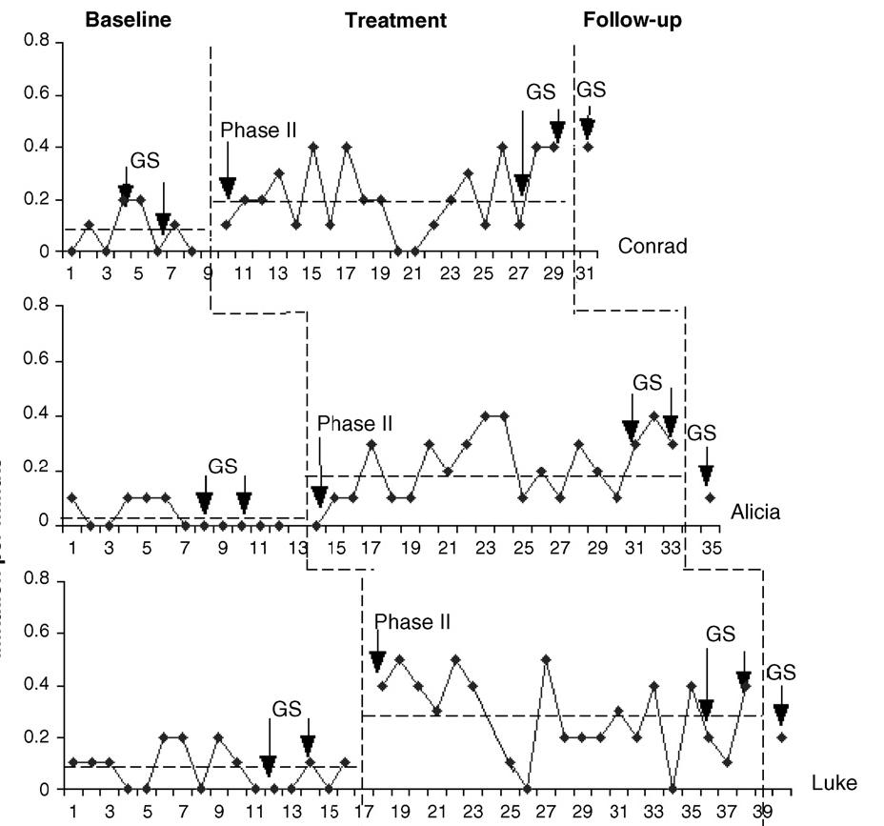

Slide 24
Multiple baseline design - advantages
User-friendly because treatment applied in a gradual way
Ineffective intervention can be altered before being extended to other baselines.
No temporary loss of gains (as in ABAB design)
Number of baselines needed – at least two, but three or four would be better.

