Slide 1
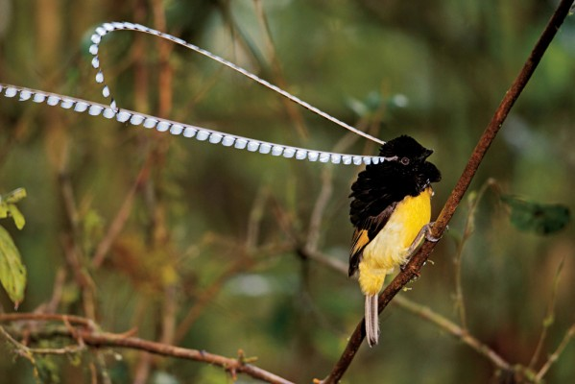
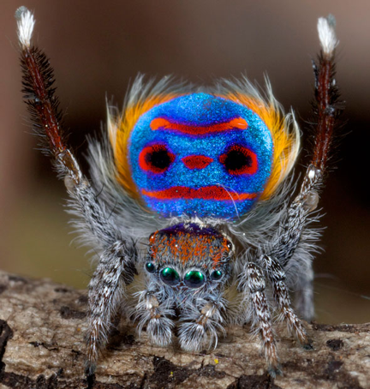

Slide 2
Sexual selection can drive speciation

Slide 3
…and extinction

Slide 4
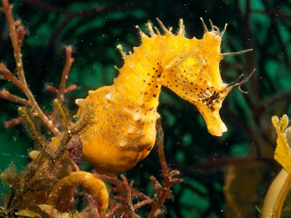
Major questions:
Why do males* compete for access to females?
Why are females* so choosy?
direct & indirect benefits
sexy sons, good genes
*Except for sex-role reversed species

Slide 5
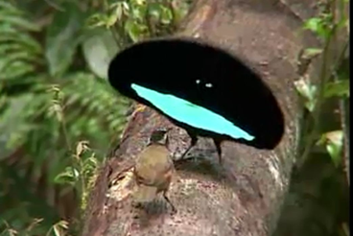
Eager males, coy females
“That males … eagerly pursue the females, is notorious to everyone… The female, on the other hand, with the rarest exceptions, is coy and may often be seen endeavouring for a long time to escape the male.” (Darwin 1871)

Slide 6
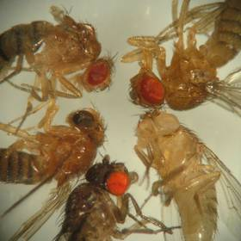
Why the sex difference in behaviour?
Bateman’s fly experiments
stocked breeding vials with equal numbers females & males
for each individual, determined
# of offspring (reproductive success) [how?]
# of mates (mating success)

Slide 7
1. Male vs female reproductive success
frequency
number of offspring (repro success)
average reproductive success
variance around this average
maximum reproductive success

Slide 8
2. Male vs female mating success
frequency
number of mates (mating success)
higher variance in males… some get no mates, some have many

Slide 9
3. Mating success vs reproductive success
What about sex role reversal?
Could Bateman gradients ever be positive for BOTH sexes?
Are Bateman gradients ever negative?
Bateman gradients
offspring
mates

Slide 10
Bateman’s principles and sexual selection
males and females have equal average fitness, but different potential fitness and variance in fitness (Bateman 1948)
fitness of males, but not of females, increases with number of mates (Bateman 1948)
sex with the steeper Bateman gradient experiences sexual selection, and competes for access to the opposite sex

Slide 11
Major questions:
Why do males compete for access to females?
Why are females so choosy?
direct & indirect benefits
sexy sons, good genes and the lek paradox

Slide 12
Being a choosy female can be time-consuming and dangerous. Why not just mate with the first male you meet? How do females benefit from being choosy?

Slide 13
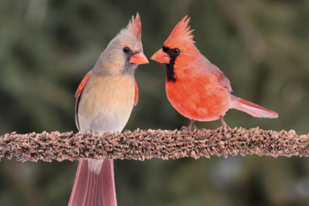
Direct benefits: resources or care
But in many species, males don’t provide direct benefits, yet females are still choosy

Slide 14
Indirect (genetic) benefits: (1) Sexy sons
Haploid, 2 locus model (T and C)
Starting frequencies:
50% males have the trait (T)
50% males lack the trait (t)
50% females are choosy (C)… only mate with T males
50% females are not choosy (c) … mate with either T or t males

Slide 15
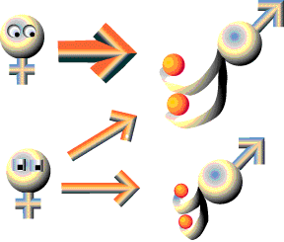
Sexy son = runaway = Fisherian selection
starting haplotype frequencies:
0.25 TC
0.25 Tc
0.25 tC
0.25 tc
next generation:
0.5 TC
0.25 Tc
0 tC
0.25 tc
http://bio.research.ucsc.edu/~barrylab/classes/animal_behavior/BOX_3_1.HTM

Slide 16
Sexy son = runaway = Fisherian selection
T males attract more mates
f(C) increases as f(T) increases
T males get even more mates… positive feedback
Do loci T and C need to be on the same chromosome to become genetically correlated?
Would this process be effective if we started with very low f(C)?
How would this model work for diploid organisms-- does it require certain dominance relationships among alleles?
What does this model assume about costs of alleles T & C?

Slide 17
Indirect (genetic) benefits: (2) Good genes
Sexy sons: female preferences are arbitrary
Good genes: female preferences are adaptive
only high-quality males can produce attractive traits
offspring of attractive dads inherit good genes, survive better

Slide 18
But if good genes are so important, why is there still variation in male attractiveness and quality?
“Lek Paradox”
male trait signals genetic quality
what happens to genetic variation at a locus when it experiences sustained directional selection?

Slide 19
Genic capture models solve the paradox via selection/mutation balance
trait itself may be polygenic: trait itself is a large mutational target
(Pomiankowski & Møller 1990)
trait expression may depend on condition, which is polygenic: condition is a large mutational target
(Rowe & Houle 1996)

Slide 20
Summary: Sexual selection
Bateman gradients predict which sex competes, which sex chooses, and the intensity of sexual selection
Mate choice can be costly, but choosing the best mate confers material and/or genetic benefits

