Slide 1
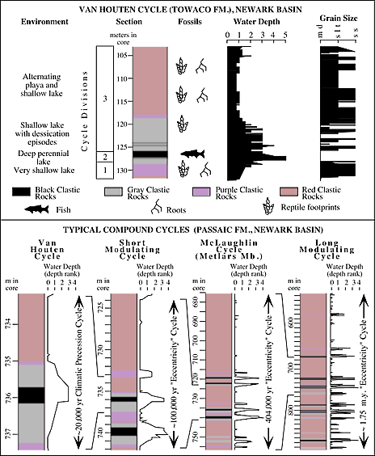
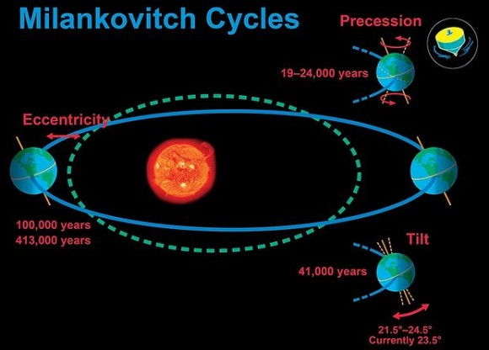
“On average, the short modulating cycles contain five Van Houten cycles (range of four to six), the McLaughlin cycles contain four short modulating cycles, and the long cycles contain four to five McLaughlin cycles.
The expression of McLaughlin cycles is the strongest and that of the long modulating cycles is the weakest.”
~20 ka
~100 ka
~413 ka
~1.75 Ma
Olsen, P. E., Kent, D V., Cornet, B., Witte, W. K., and Schlische, R. W., 1996, High-resolution stratigraphy of the Newark rift basin (Early Mesozoic, Eastern North America): Geological Society of America, v. 108, 40-77.
GC Herman TCNJ 2015

Slide 2
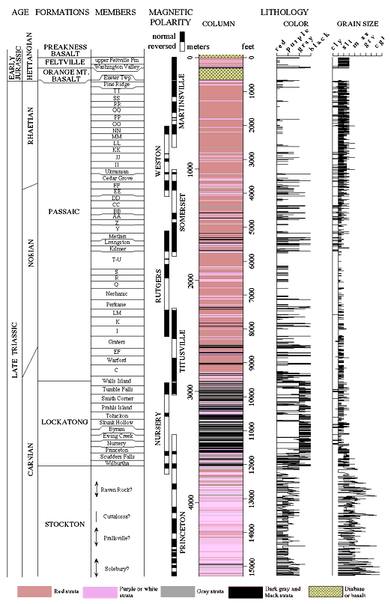
About 60 members in the ~15,000-foot Triassic section
60 x 413 ka = ~25 million years
GC Herman TCNJ 2015

Slide 3
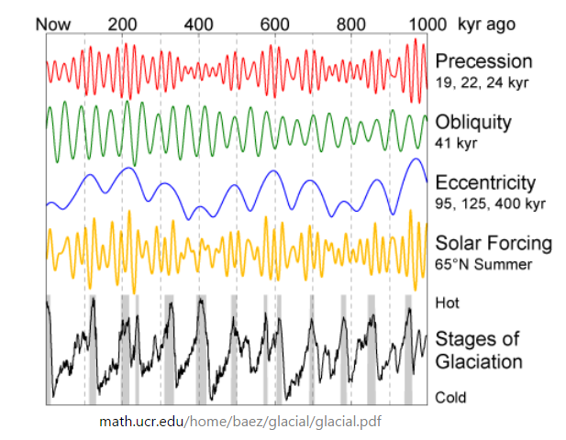
Fear not,
climate change happens naturally…
0.07
0
Wisconsinan
~100 kz cycle
solar insolation increases with higher eccentricity
Illinoisan
Pre-Illinoisan
A value of 0 is a circular orbit, values between 0 and 1 form an elliptical orbit. Earth's orbit is nearly circular. The current eccentricity is ~0.0167; with a minimum of ~0.0034 to a maximum of ~0.068 as a result of gravitational attractions among the planets (most notably Jupiter and Saturn).
GC Herman TCNJ 2015

